Slide 1

ASSESSING ISSUES AROUND
POVERTY IN NIGERIA
A RESEACH PROJECT BY TEAM 8 STUDENTS,
DATA SCIENCE TRACK, COHORT 4, AISATURDAYS,
UNIVERSITY OF LAGOS, LAGOS, NIGERIA
DECEMBER, 2019

Slide 2
Presentation Outline
Overview
Aim
Objectives
Methodologies
Results and Discussion
Recommendations
Conclusion

Slide 3
Overview
The rate of poverty in Nigeria is of great concerns
According to the 2019 global Multidimensional Poverty Index (MPI), it was estimated that more Nigerians are multidimensionally poor than a decade before 2017
Based on the afore-mentioned facts, this project provides insights into issues around poverty in Nigeria. It takes information from a questionnaire administered to over 300 respondents in Nigeria
At the end, the project looked at the perception of the people about the country and government functionaries.
It suggests recommendations as possible strategies in ameliorating the negative consequences of poverty in the country

Slide 4
Aim
To assess the prevailing issues around POVERTY in Nigeria

Slide 5
Objectives
The key project objectives were to assess:
The rate of employment in Nigeria
Respondents’ Salary earnings per month
Respondents’ Income from other sources
Job satisfaction across salary ranges
The level of incomes Satisfaction
Major expenses incurred by Nigerians
Level of tax payment
Major desires of Nigerians to own assets
Perception of People about the Country and Government Officials

Slide 6
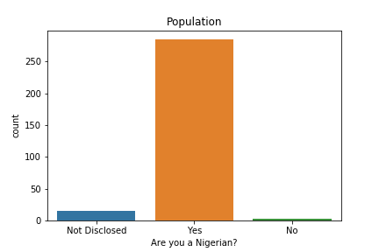
Socio-demographics of the Respondents
Majority of the respondents were Nigerians which accounted for 285(94.0%) of total respondents.
Non-Nigerians accounted for 3(1.0%), while 15(5.0%) respondents did not reveal their nationality identity.
The result suggests that more Nigerians participated in this survey

Slide 7
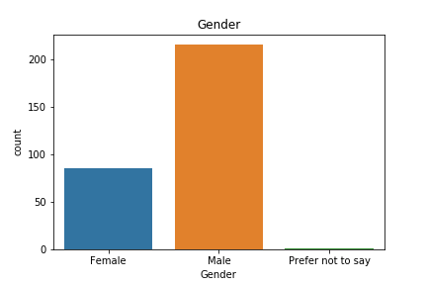
Socio-demographics of the Respondents (Cont’d)
216(70.0%) of total respondents were males while 86(30.0%) were females.
It suggests that more males participated in this study than their female counterparts

Slide 8
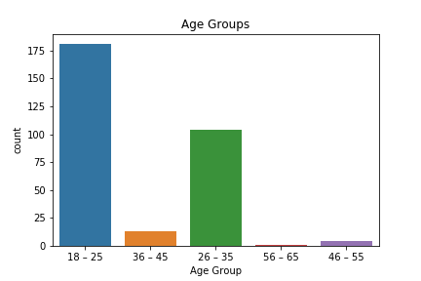
Socio-demographics of the Respondents (Cont’d)
It was observed that:
181(60.0%) of total respondent were 18-25 years of age
104(34.0%) were 26-35 years, 13(4.0%) were 36-45 years, while 4(1.0%) were 46-55 years.
The modal and least age groups were 18-25 and 56-65 respectively

Slide 9
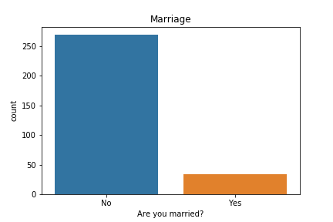
Socio-demographics of the Respondents (Cont’d)
34(10.0%) of total respondents were married while 269(90.0%) were not

Slide 10
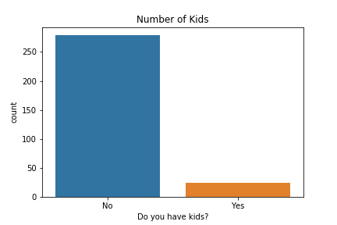
Socio-demographics of the Respondents (Cont’d)
24(10.0%) of total respondents have kids while 279(90.0%) do not have.

Slide 11
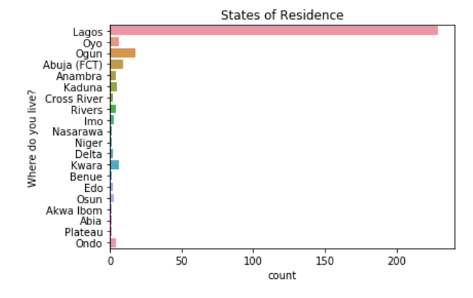
Socio-demographics of the Respondents (Cont’d)
Majority of the respondents 229(76.0%) reside in Lagos, followed by Ogun state with 18(6.0%)
States such as Abia, Akwa Ibom, Benue, Nasarawa, Niger and Plateau had one respondent each.
The result shows that respondents cut across twenty states in Nigeria

Slide 12
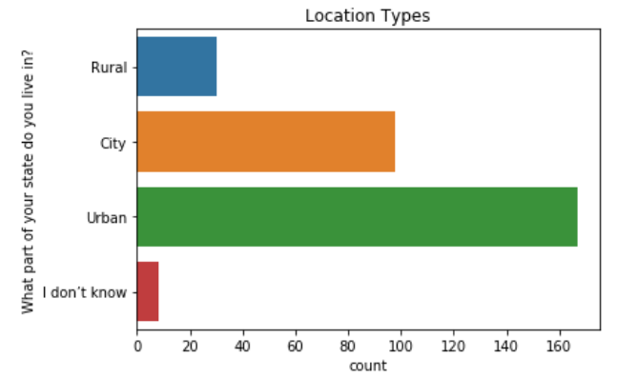
Socio-demographics of the Respondents (Cont’d)
Majority of the respondents 167(55.0%) were located in Urban areas
98(32.0%) of respondents stay in cities
30(10.0%) were located in Rural areas
8(3.0%) preferred not to disclose their location identities.

Slide 13
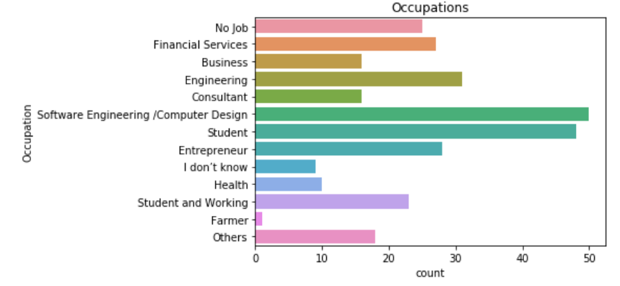
Results and Discussion:
Rate of Employment Among Respondents
50(7.0%) have ICT related occupations; a pool of students 48(6.0%); a person belonged to farming category
The people with no job accounted for 25(8.0%). If this number is added to the respondents in student category 48(6.0%), it means the employment rate among the respondents is 86%

Slide 14
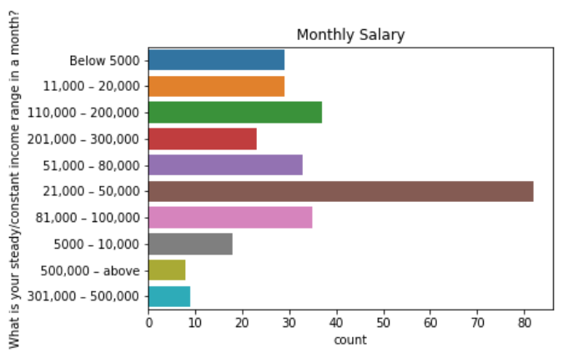
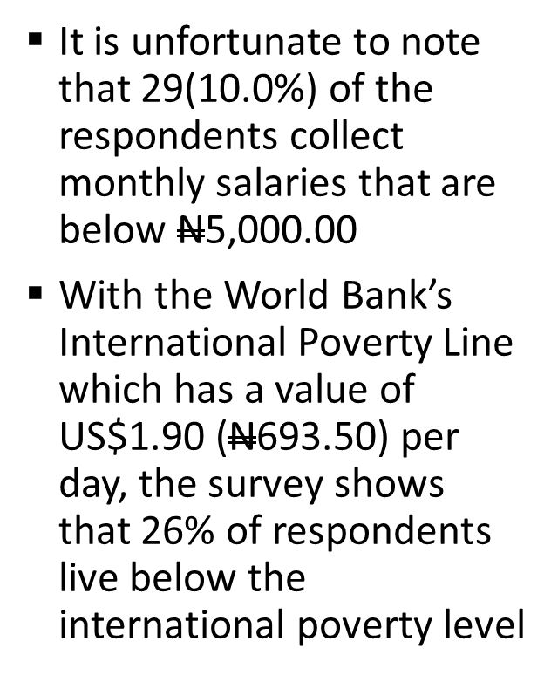
Results and Discussion:
Salary Earnings per Month

Slide 15
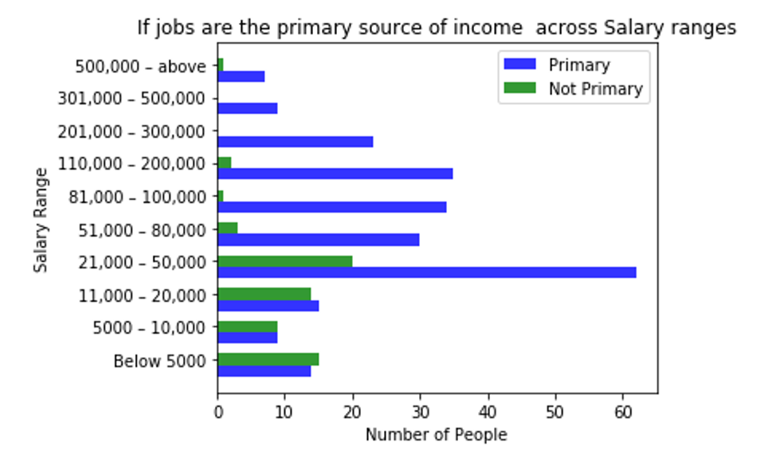
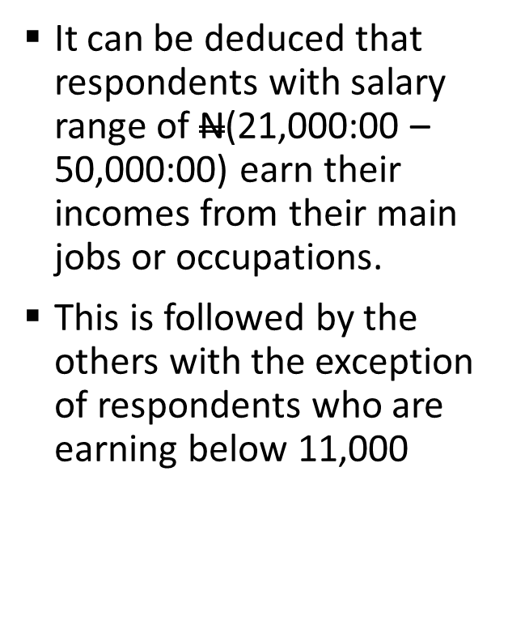
Results and Discussion:
Income from other Sources

Slide 16
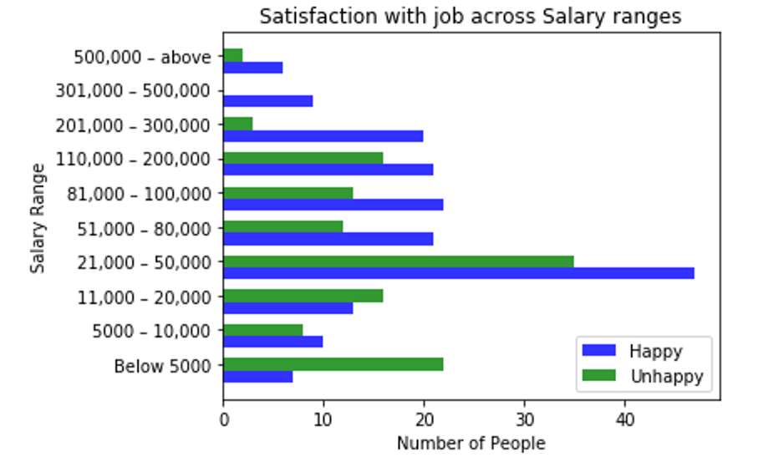
Results and Discussion:
Job satisfaction Across Salary Ranges

Slide 17
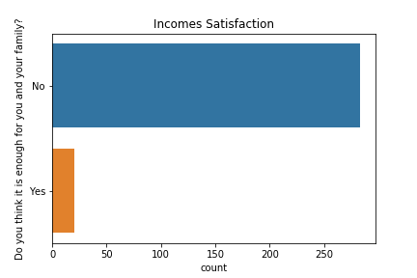
Results and Discussion:
Level of Incomes Satisfaction
Majority of the respondents 283(93.0%) affirmed that they were not satisfied with the level of their incomes
Due to the high level of job un-satisfaction, the survey revealed that the respondents are involved in other side jobs such as freelancing, buying and selling, contracting and betting (Bet Naija)

Slide 18
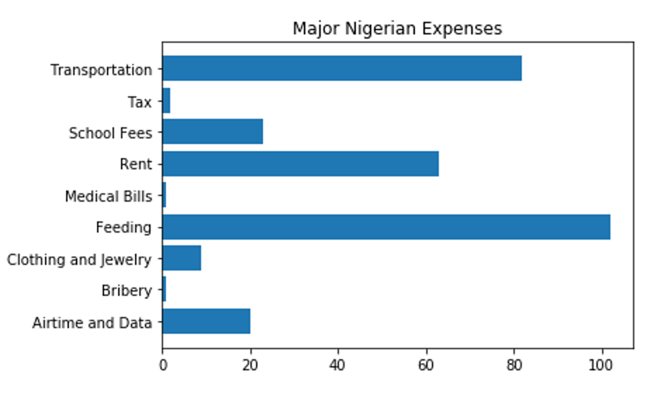
Results and Discussion:
Major Expenses incurred by Nigerians
Majority of Nigerians spent the largest percentage of their incomes on feedings, closely followed by transportation and rents.
Minimal amount of incomes were spent on medical bills, bribery and tax payment

Slide 19
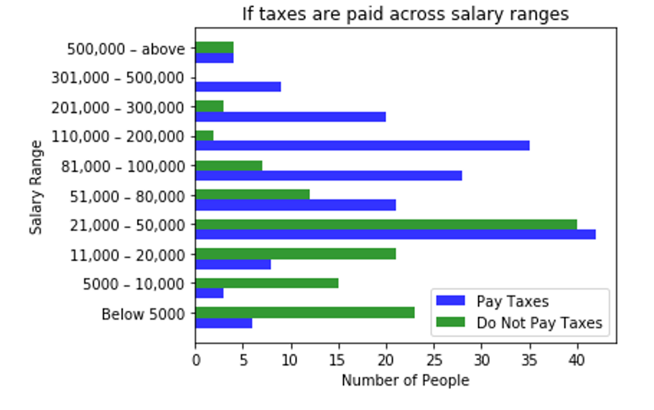
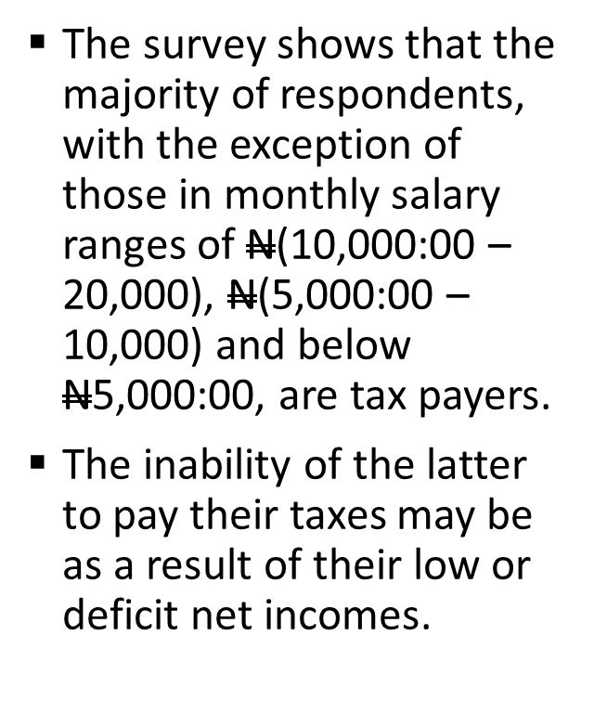
Results and Discussion:
Level of Tax Payment

Slide 20
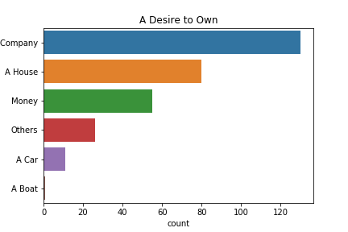
Results and Discussion:
Major Desires of Nigerians to own Assets
Majority of the respondents 130(43.0%) have strong desires to have companies so that they can be able to stand on their own and also foot their own bills.
Very few people 11(4.0%) desired to have cars as their assets

Slide 21
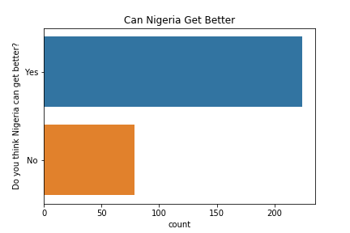
Results and Discussion:
Perception of People about the Country
Despite the present dwelling socio-economic status of the country, majority of the respondents 224(74.0%) strongly believe in the turn-around of the country in the nearest future

Slide 22
Results and Discussion: Perception of People about the Government Officials
The respondents described the prevailing poverty level in Nigeria to the ways and manners in which government functionaries have been managing the socio-economic affairs of the country
Most respondents described these government functionaries as greedy, not accountable to the citizens, corrupt, careless about the welfare of the citizens, insensitive, clueless, heartless, disrespectful to the rule of law, nepotic, directionless, unpatriotic, manipulative, looters, and indifferent set of leaders.

Slide 23
Recommendations
Based on the outcomes of this survey, we would like to recommend the following to the government and other policy makers in order to strengthen the socio-economic well-being of Nigerian residents:
The current economic level of majority of respondents are low. Thus, the government need to come up with workable policies that will usher-in the economic prosperity of Nigerian residents.
People should be economically empowered in order to earn more legally and thus pay more taxes into the covers of governments.
Palliative measures should be made available to the frustrated and/or jobless residents.
Government should help in diversifying the economy in other for the residents to have more economic powers.
There should be provision of infrastructures for the residents. This will help the existing SMEs to grow and stimulate more other ones to be established.
Nigerians spend most of their incomes on feeding, transportation and house rents. All these and many more social services should be subsidized by the government in order to lessen their costs on the residents.

Slide 24
Conclusion
We strongly believe that if the insights provided by the analysis of this survey are put into use, it will go a long way:
In changing the fortune of Nigerian residents to change
Increase the standard of living
Reducing the negative effects of poverty and position Nigeria better in the comity of nations

